Slide 1

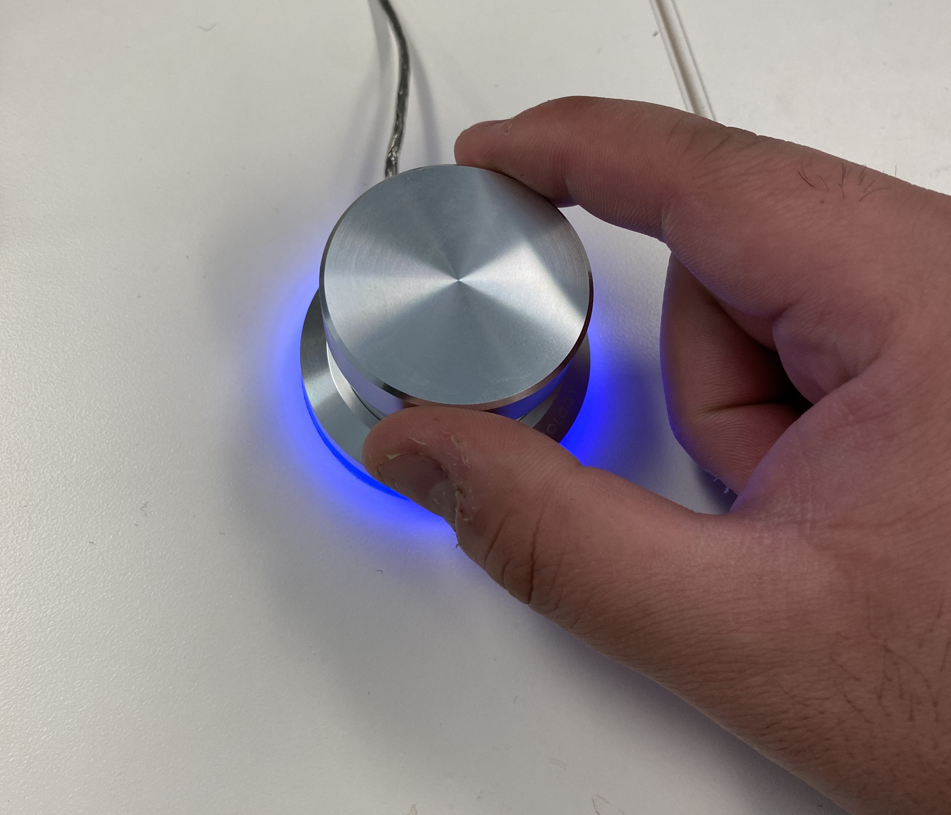
Sound Check
Practice
Position your hands so that your
thumb and index finger wrap around the dial knob.
KEEP ROTATING TO THE RIGHT TO CONTINUE
Notes:
Outside the scanner

Slide 2
Before we get started we need you to select what
volume feels most comfortable for you.
KEEP ROTATING TO THE RIGHT TO CONTINUE

Slide 3

When the sound check begins you will be played the sound of a baby laughing and shown the following image.
KEEP ROTATING TO THE RIGHT TO CONTINUE

Slide 4
To increase the volume, rotate the dial to the right.
To decrease the volume, rotate the dial to the left.
To select the volume, press down on the dial.
KEEP ROTATING TO THE RIGHT TO CONTINUE

Slide 5
Keep rotating the dial to the RIGHT when you are ready to begin.

Slide 6
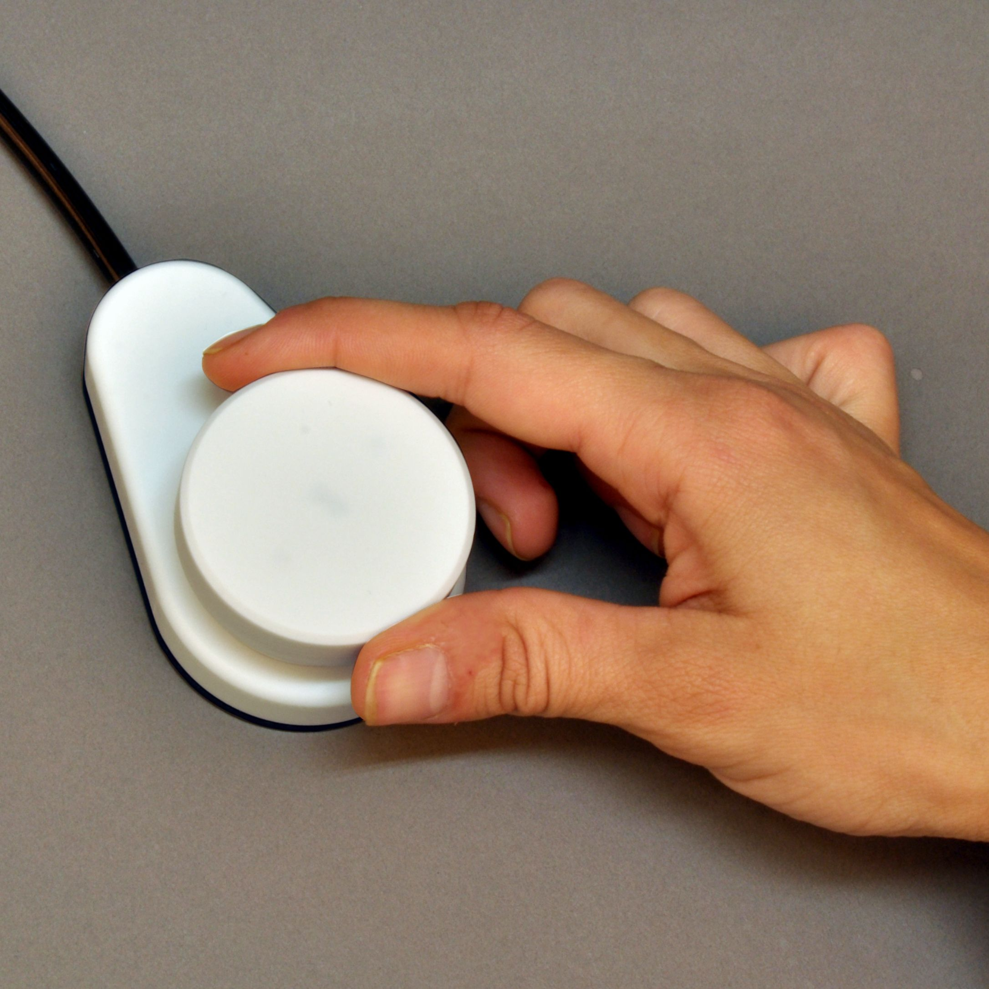
Sound Check
Scanner
Position your hands so that your
thumb and index finger wrap around the dial knob.
KEEP ROTATING TO THE RIGHT TO CONTINUE
Notes:
Outside the scanner

Slide 7
Before we get started we need you to select what
volume you can hear comfortably over the scanner.
KEEP ROTATING TO THE RIGHT TO CONTINUE

Slide 8
When the sound check begins, the scanner will be turned on and you will be played the sound of a baby laughing and shown the following image
KEEP ROTATING TO THE RIGHT TO CONTINUE

Slide 9
To increase the volume, rotate the dial to the right.
To decrease the volume, rotate the dial to the left.
To select the volume, press down on the dial.
KEEP ROTATING TO THE RIGHT TO CONTINUE

Slide 10
Keep rotating the dial to the RIGHT when you are ready to begin.

